Slide 1
-TITLE-
EMPLOYEE ADMINISTRATION SYSTEM
Using React JS + Spring Boot Microservices + MySQL
Presented By: 1. Sahil Totade (230341220154)
2. Mayur Kasbe (230341220098)

Slide 2
-INTRODUCTION-
The Employee Administration System is a comprehensive software solution that aims to streamline employee-related operations within an organization. Developed using Spring Boot for the backend and React for the frontend, the system facilitates user authentication, department management, manager registration, employee management, and salary administration. This document outlines the requirements, features, and specifications of the system.

Slide 3
-OBJECTIVES-
The purpose of the Employee Administration System is to provide an efficient and user-friendly platform for managing employee-related tasks.

Slide 4
-TECHNOLOGY USED-
Java - Spring Boot Microservices
React JS
MySQL
Maven
BootStrap

Slide 5
-SOFTWARE USED-
STS (Spring Tool Suite
VS Code (Visual Studio Code)
MySQL Workbench

Slide 6
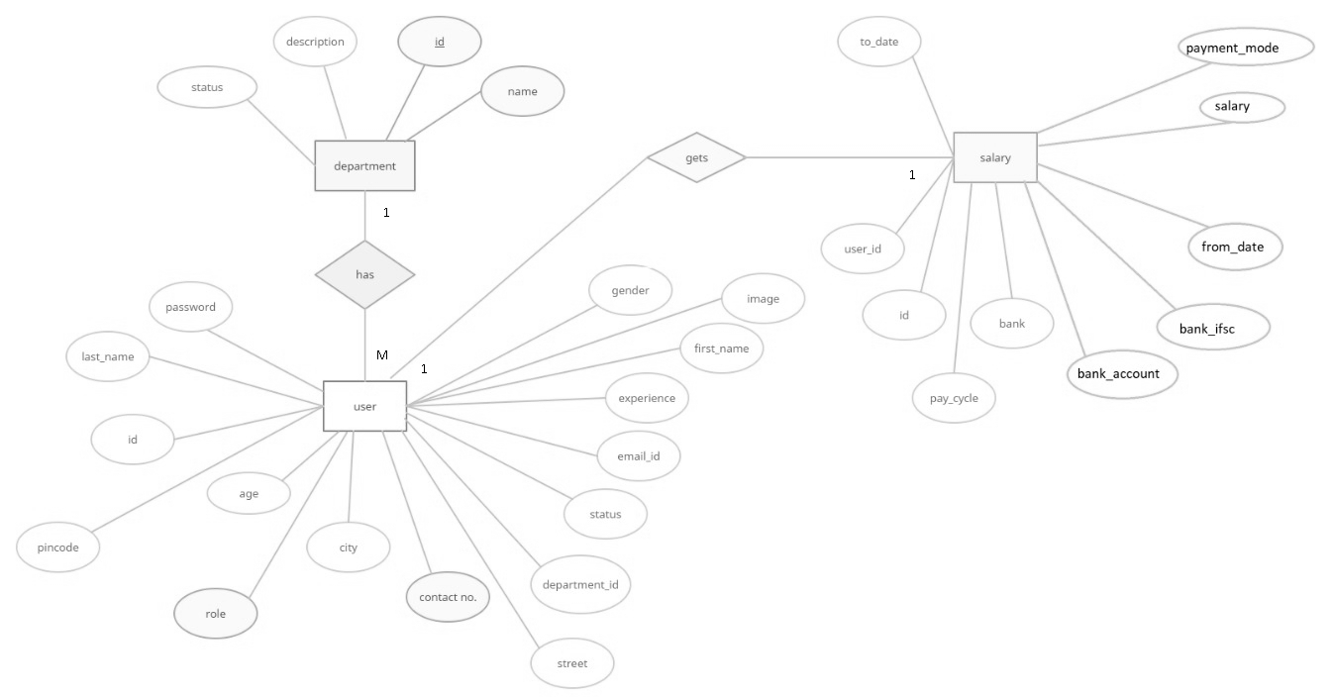
-E-R Diagram-

Slide 7
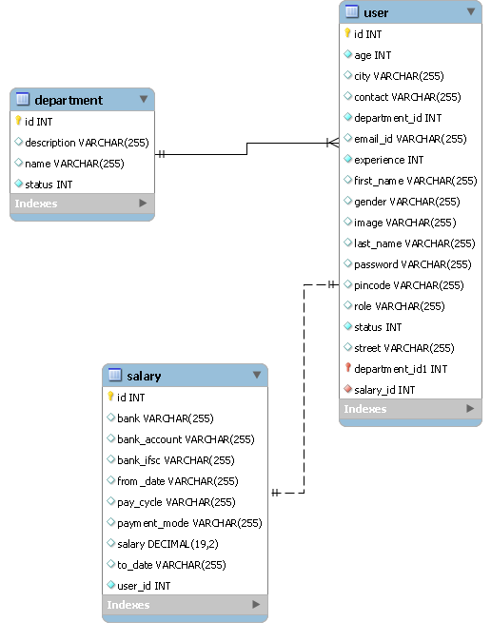
-Class Diagram-

Slide 8
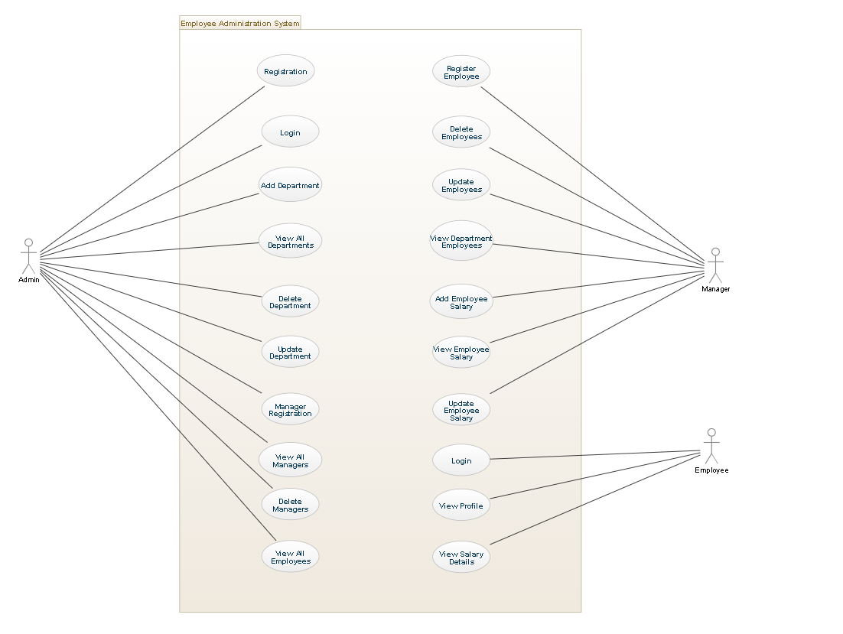
-Use Case Diagram-

Slide 9
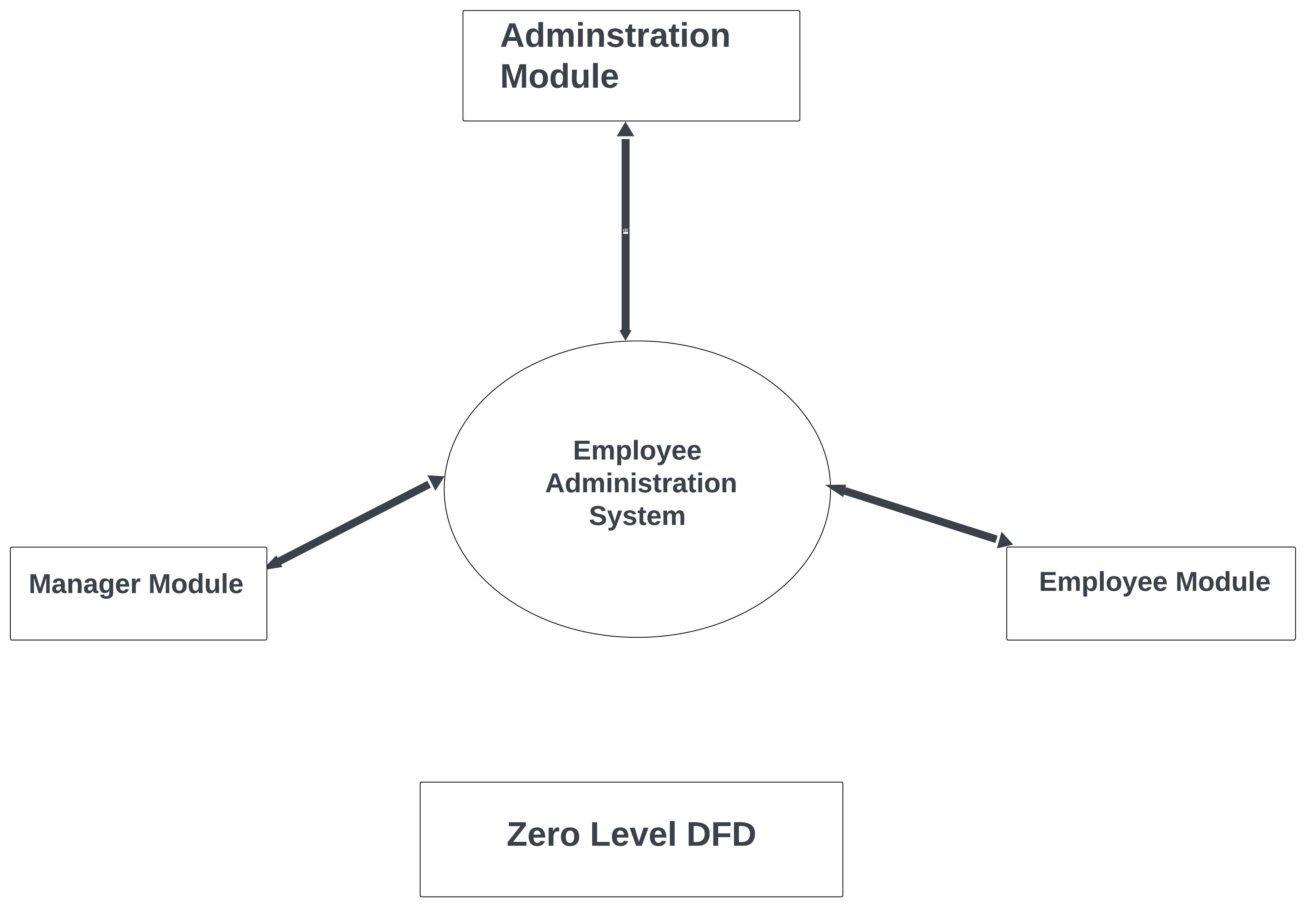
-Zero Level Diagram-

Slide 10
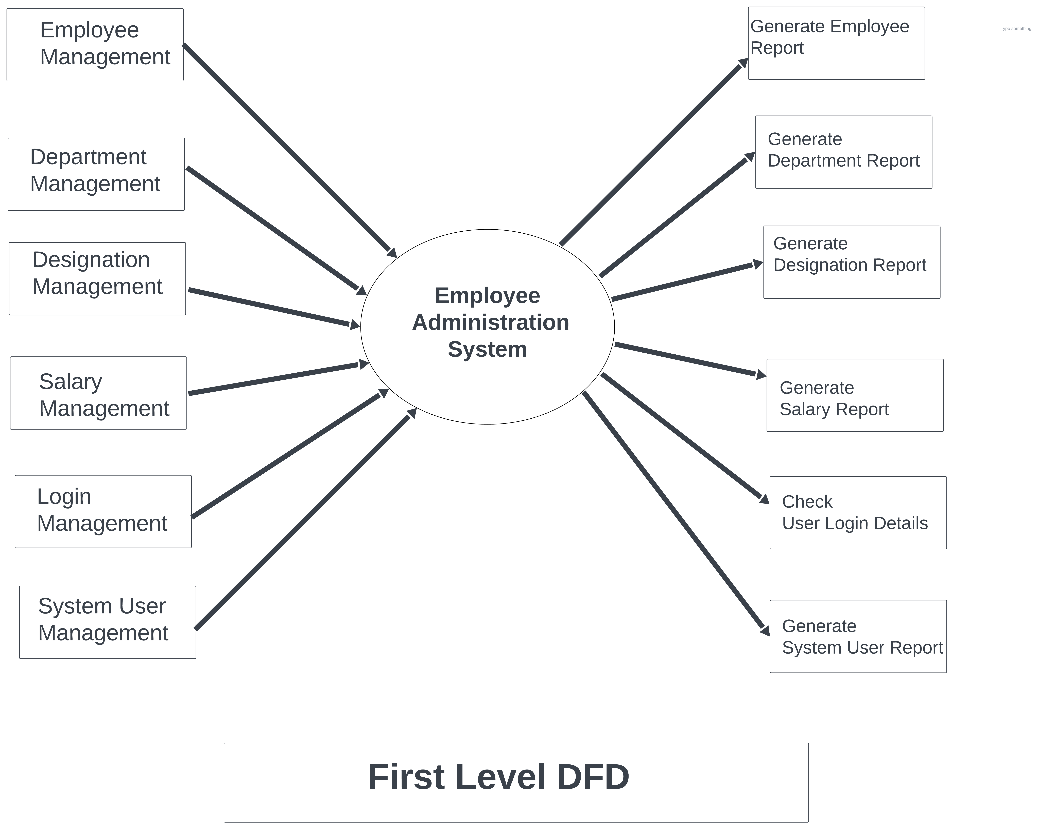
-First Level DFD-

Slide 11
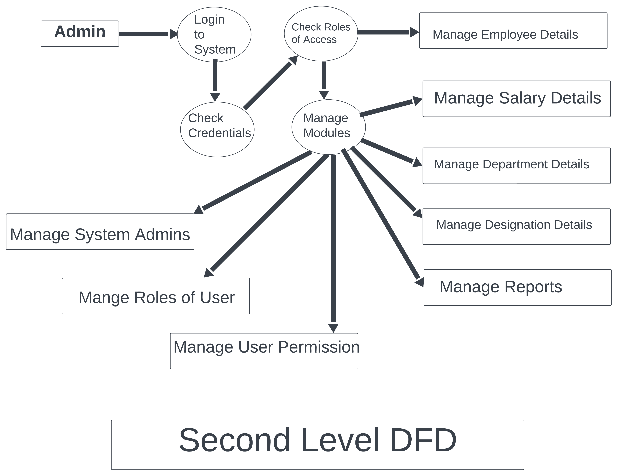
-Second Level DFD-

Slide 12
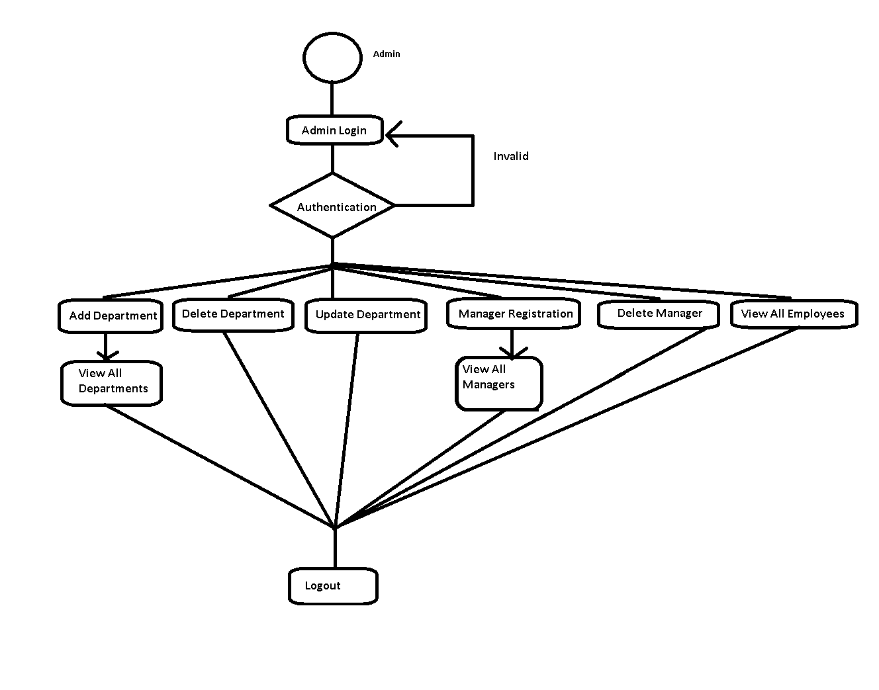
-Admin Activity-

Slide 13
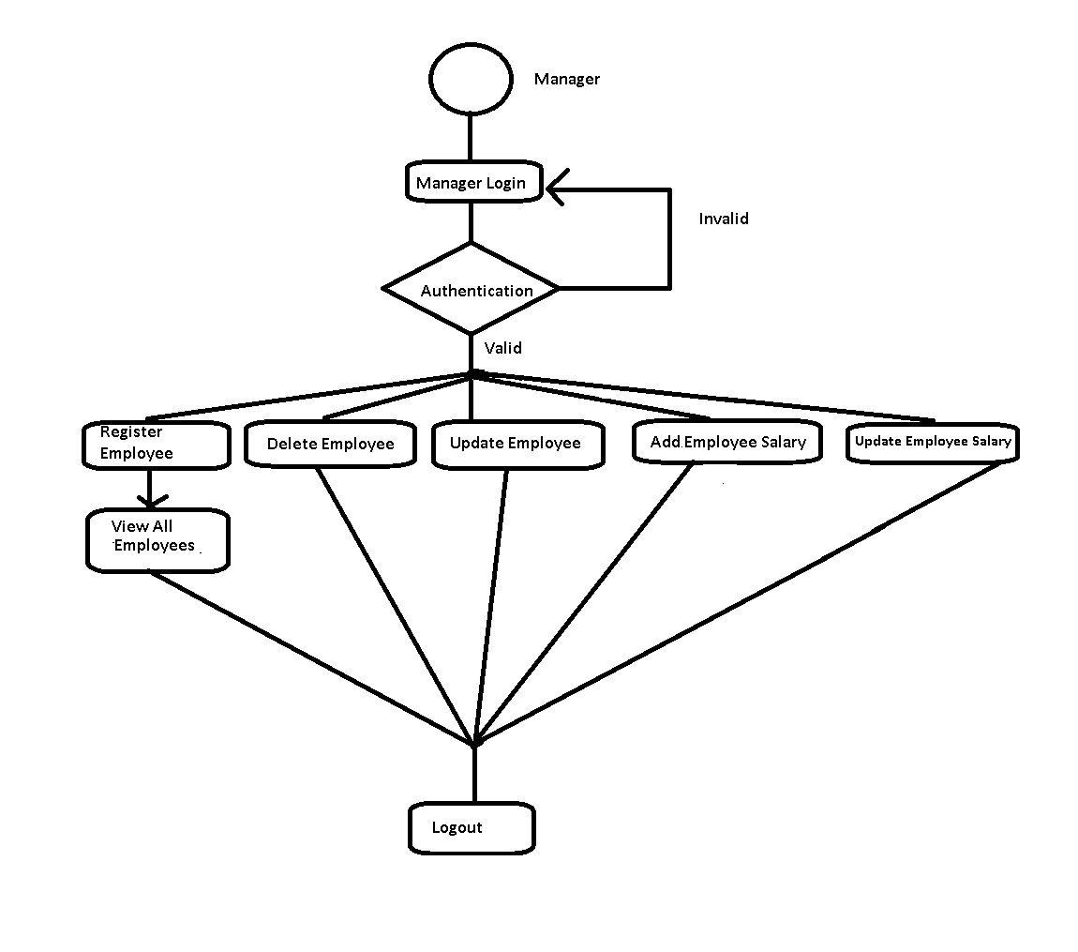
-Manager Activity-

Slide 14
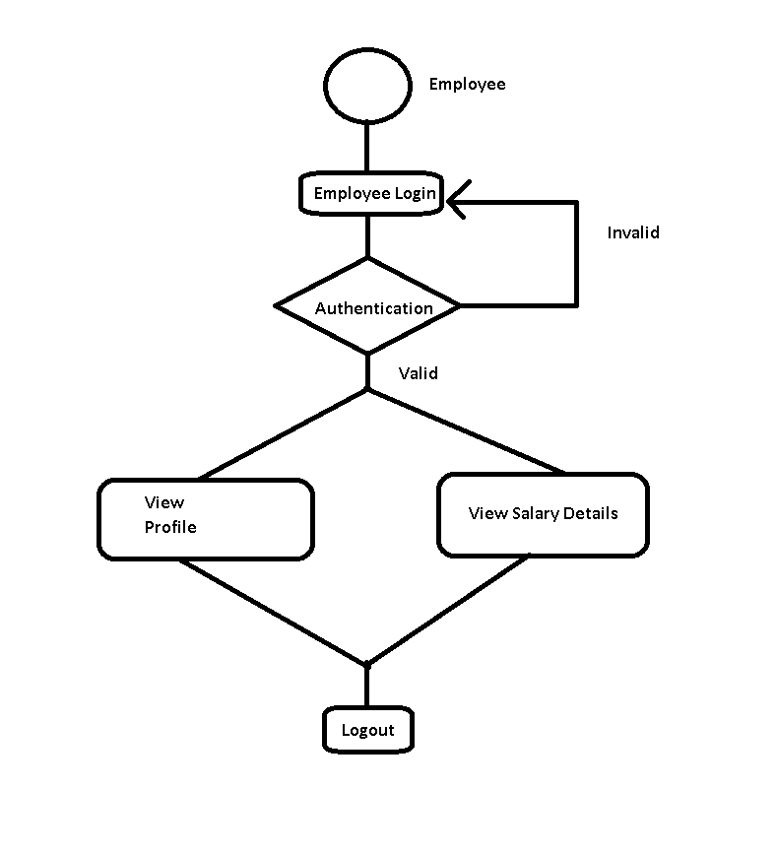
-Employee Activity-

Slide 15
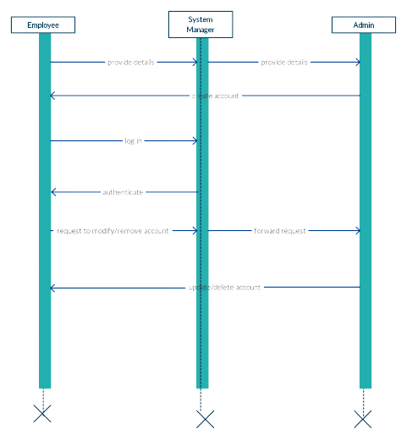
-Sequence Diagram-

Slide 16
-USER MODULES-
The project basically has three user modules:
1) Administrator Module
2) Manager Module
3) Employee Module

Slide 17
-FUNCTIONAL MODULES-
1) User Authentication Module:
2) Department Module:
3) Manager Module:
4) Employee Module:
5) Employee Salary Module:

Slide 18
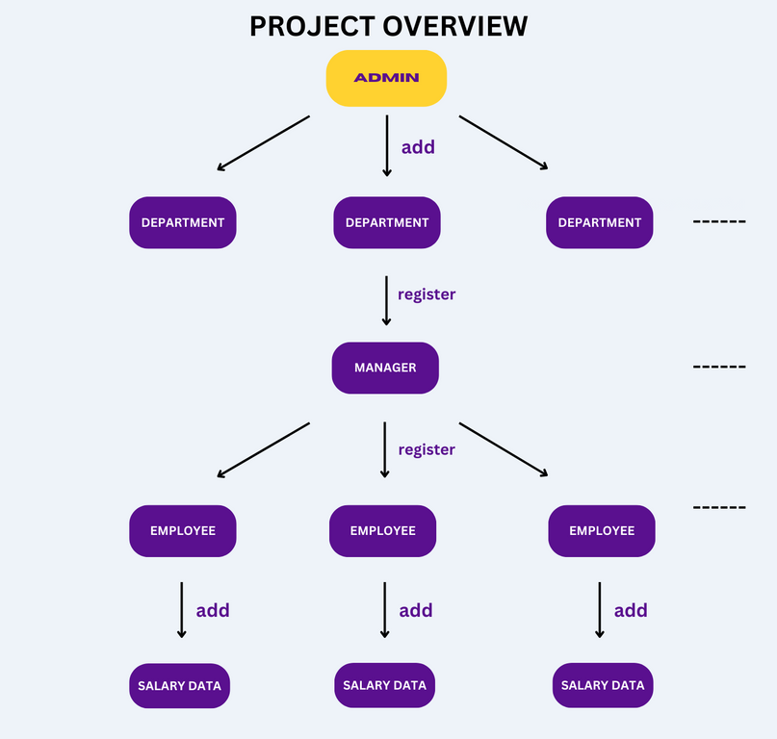
-PROJECT OVERVIEW-

Slide 19
-BACKEND STRUCTURE-
Employee Management System Spring Boot Microservices:
1) API Gateway Service
2) Service Registry Service
3) Employee User Service
4) Employee Department Service
5) Employee Salary Service

Slide 20
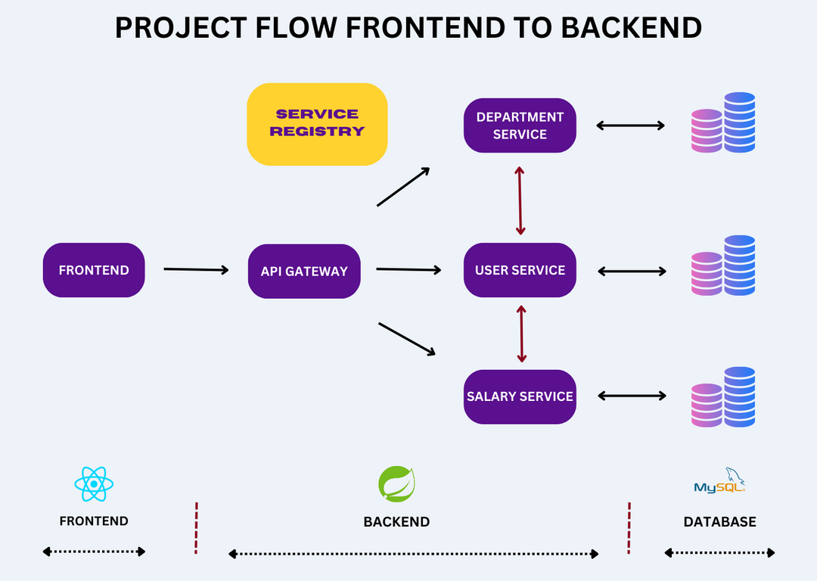
-PROJECT FLOW-

Slide 21
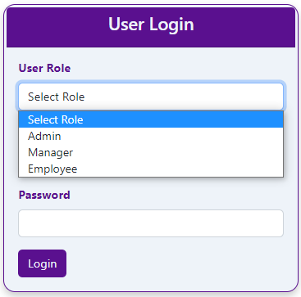
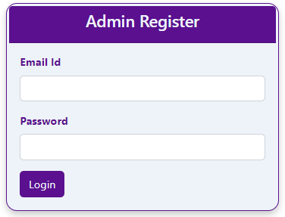
-ADMIN ROLE-
Admin can register into the system by using email and password as shown below.

Slide 22
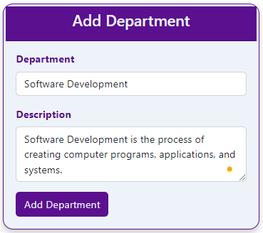
-ADMIN ROLE-
Admin can add the departments in the system as shown below.

Slide 23
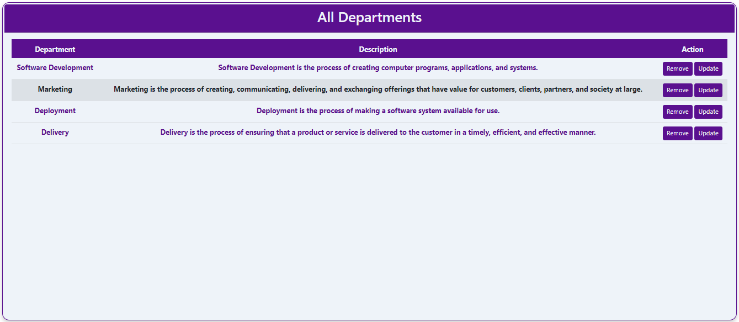
-ADMIN ROLE-
Admin can view all the departments as shown below.

Slide 24
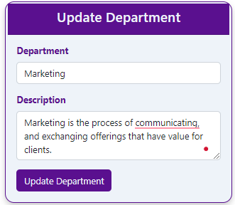
-ADMIN ROLE-
Admin can delete or update the departments by clicking on the remove button as shown above.

Slide 25
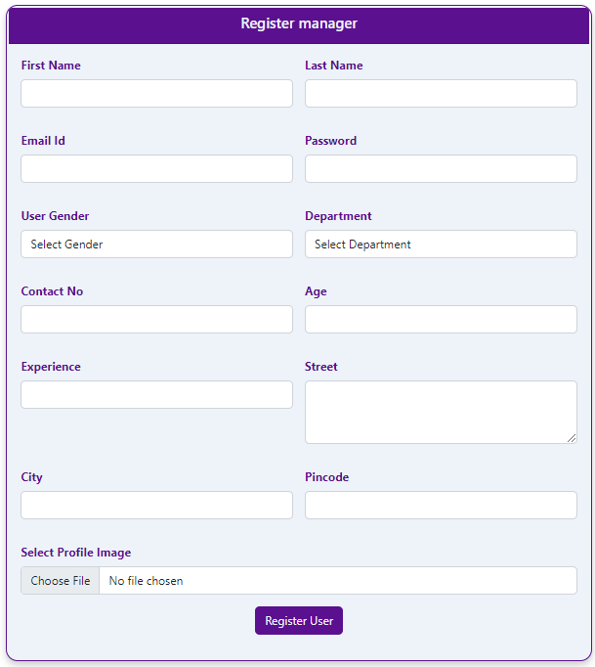
-ADMIN ROLE-
Admin can register manager for the department in employee management system application.

Slide 26
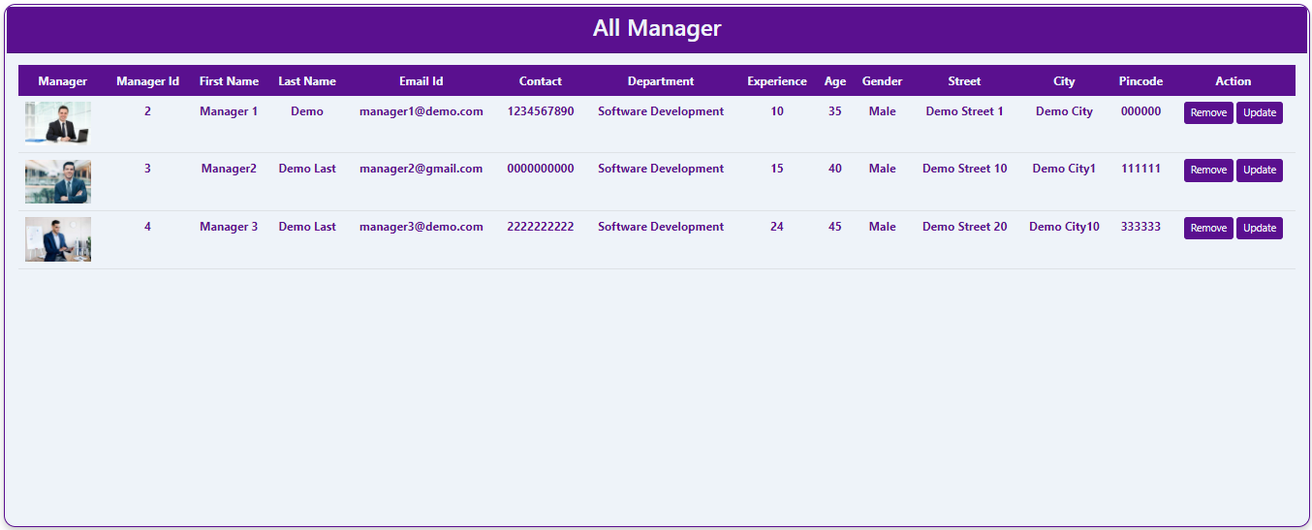
-ADMIN ROLE-
Admin can view all the managers present in the EMS application as shown below.

Slide 27
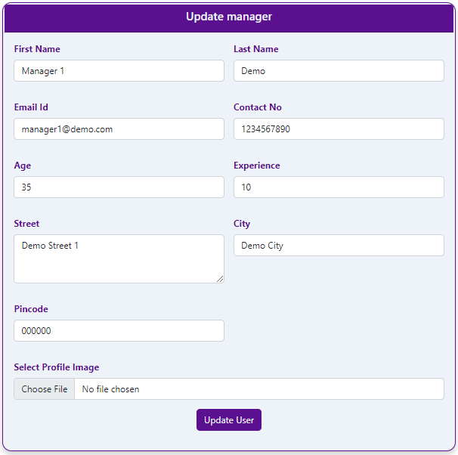
-ADMIN ROLE-
Admin can update or delete the Managers by clicking on the remove button as shown above.

Slide 28
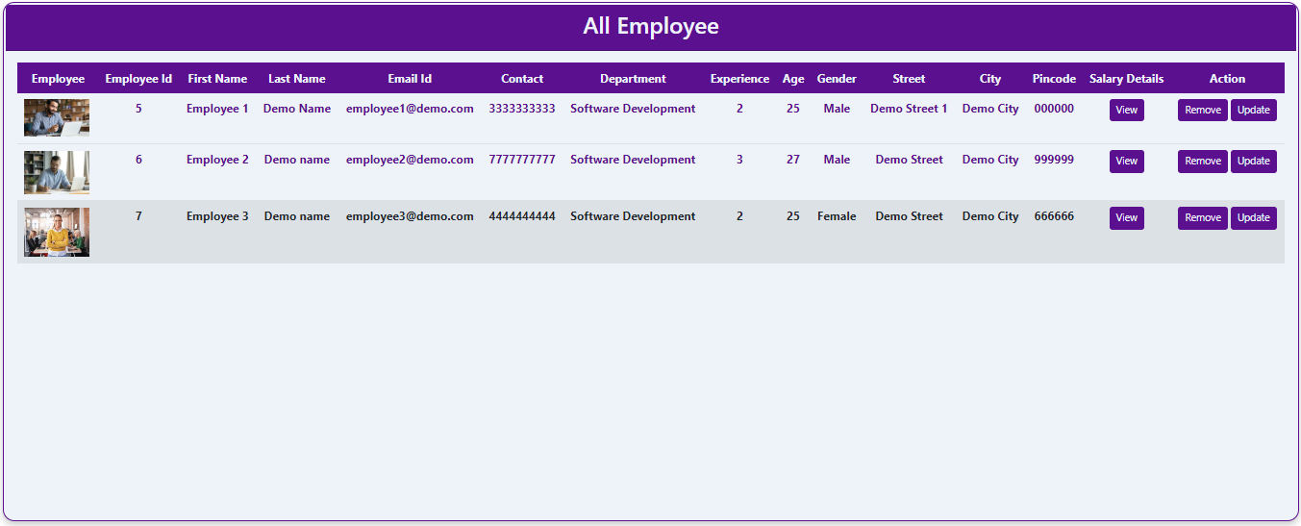
-ADMIN ROLE-
Admin can view all the employees in the departments present in the EMS application as shown below.

Slide 29
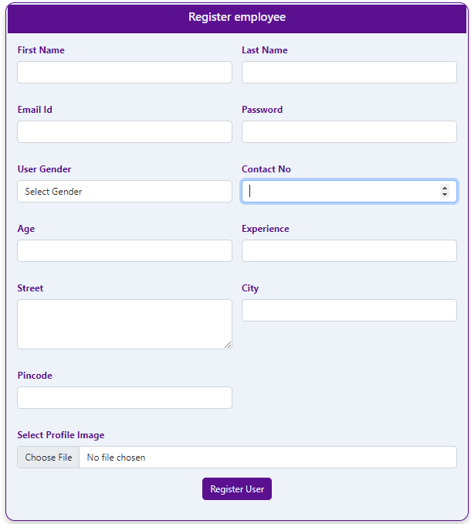
-MANAGER ROLE-
Managers can register employees into the system by using the below register employee form.

Slide 30
-MANAGER ROLE-
Manager can Delete or Update Employees
Manager can View Department Employees
Manager can Add Employee Salary
Manager can View Employee Salary
Manager can Update Employee Salary

Slide 31
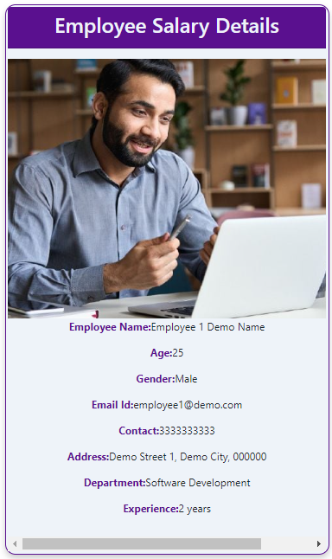
-EMPLOYEE ROLE-
After logging in to the EMS system, Employee can see their profile as shown below.

Slide 32
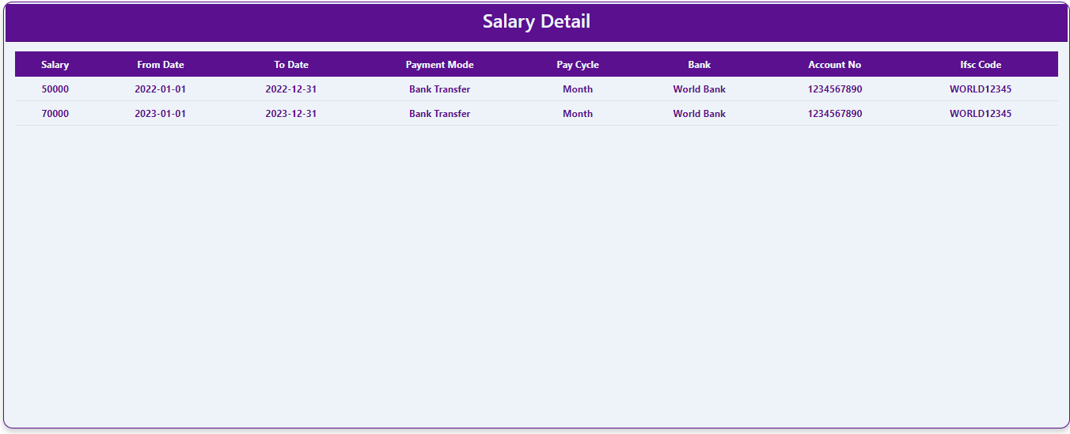
-EMPLOYEE ROLE-
An employee can see their salary details from start to end after logging into the EMS application as shown below.

Slide 33
-CONCLUSION-
Empowers administrators to efficiently manage departments, managers, employees, and salary information.
This project delves into the functionalities of an EMS wherein directors can effortlessly add departments and assign managers liable for overseeing worker control.
Additionally, the gadget allows the recording and monitoring of revenue information for each worker

Slide 34
Thank You

